Slide 1
NYPD INCIDENTS REPORT
NYPD Incidents 2006 – 2020 report By Muntadhar AlZayer

Slide 2
Introduction
NYPD collects shooting incident data
Working on data between 2006-2020
Goal:
Extrapolate information and visualize the data
Create a model to help with the prediction of future incidents

Slide 3
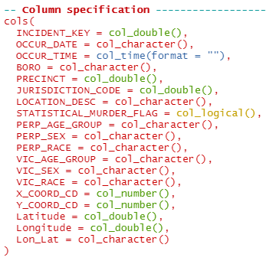
Data Provided
NYPD Reported Incidents
Each row has information about one incident
Some may be missing values

Slide 4
Visualization
Group the data based on specific columns
Borough
Year / month of incident
Other information can be used:
Perp/Victim age
Perp/Victim race
Location Coordinates

Slide 5

Visualization – Cleaning
Changing data types
Non-necessary columns

Slide 6
Visualization – Location Grouping
Group certain rows together:
Precinct & Borough
Borough

Slide 7
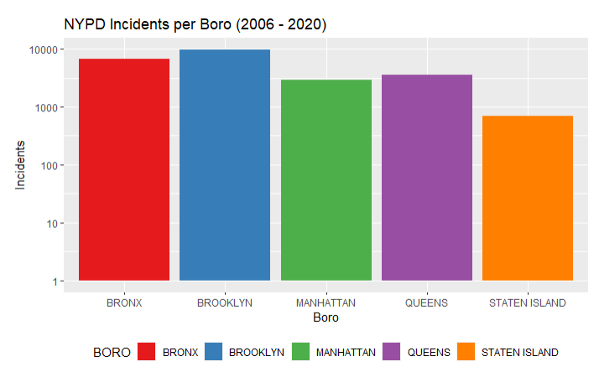
Visualization – Borough
NYPD Incidents per Borough (2006-2020)

Slide 8


Visualization – Date/Time
Grouped based on Month
Grouped based on Year

Slide 9
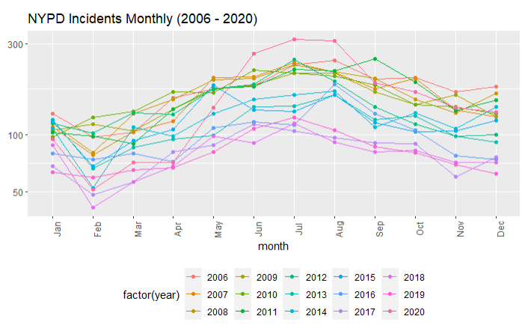
Visualization – Monthly
NYPD Incidents per Month/Year (2006-2020)

Slide 10
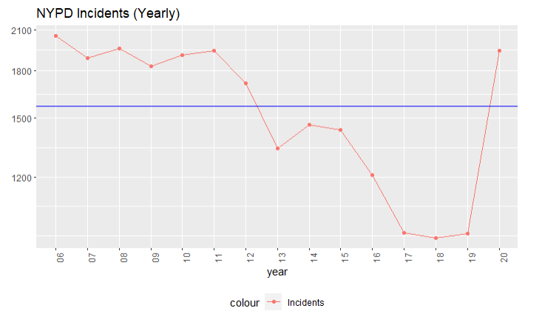
Visualization – YEarly
NYPD Incidents per Year (2006-2020)

Slide 11
Model
Create a model of the data
Find a correlation between the data
My model was based on population density

Slide 12
Model – second dataset
Imported a second dataset
Population of NYC boroughs based on age groups
Years 2010, 2015, 2020
And future predictions for 2025 – 2040

Slide 13
Model – Population density
Limited due to the years provided in the dataset
A lot of data to wrangle and group together
Population density = pop in borough / total pop of NYC
Or Population density over time

Slide 14
Model – Failure
Model failed due to wrong data provided
One datapoint of population, and one datapoint of incident stats
Learning from our failures

Slide 15
Conclusion
Modelling needs more data
Importing data that helps the modelling & visualization
Great insight into visualization of data
R is a powerful tool, but requires matplotlib to visualize better
Data Science is a field for me

